Slide 1





How do bacteria adapt to salinity?
Large-scale phylogenomics of aquatic bacteria reveal molecular mechanisms for adaptation to salinity
Krzysztof T Jurdzinski, Maliheh Mehrshad, Luis Fernando Delgado, Ziling Deng, Stefan Bertilsson, Anders F Andersson

Slide 2
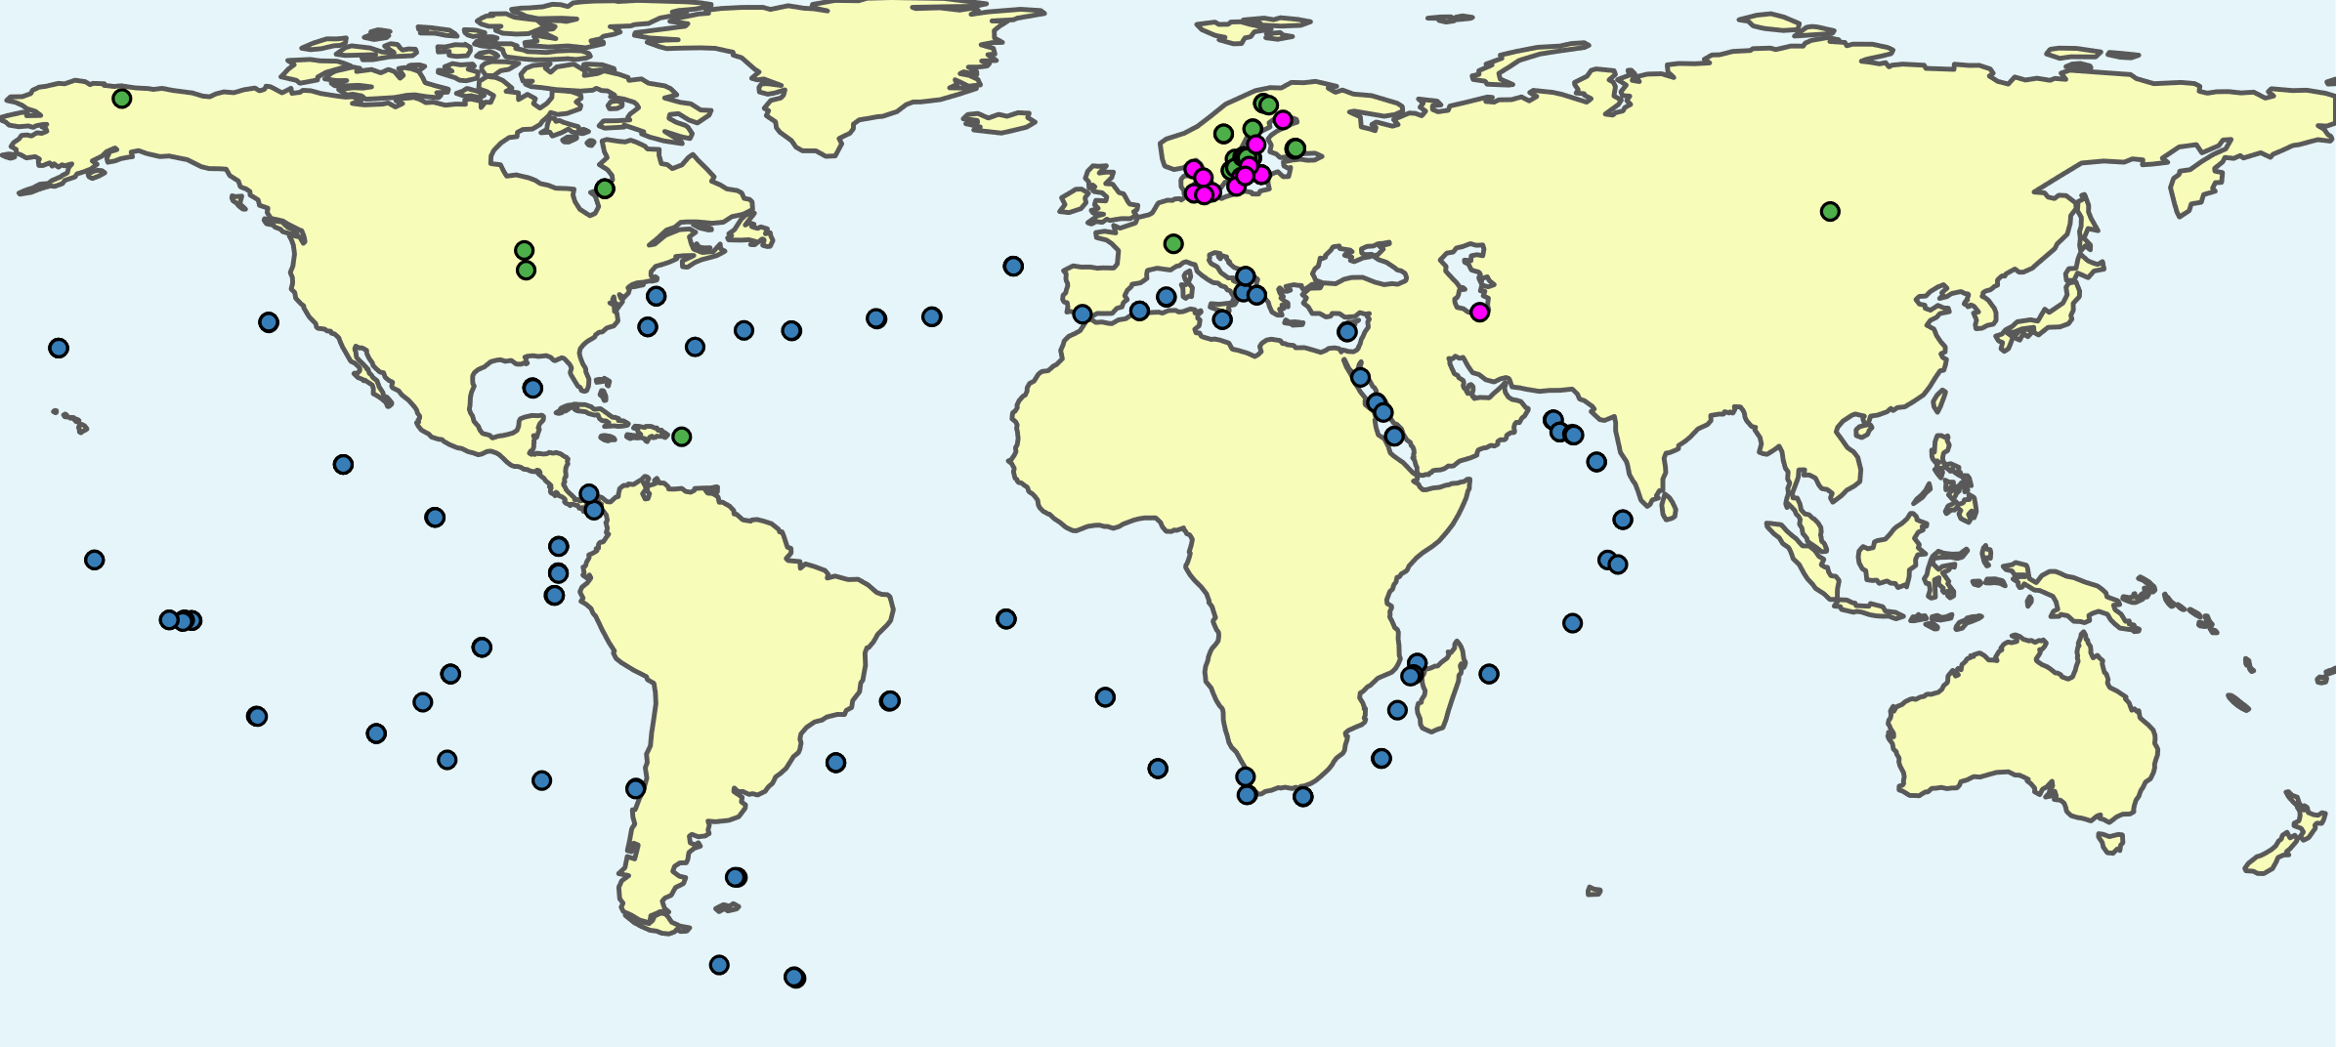
Comparative genomics based on publicly available metagenome-assembled genomes (MAGs)
Linz et al. (2018)
Buck et al. (2021)
Cabello-Yeves et.al. (2018)
Alneberg et al. (2020)
Mehrshad et al. (2016)
Tully et al. (2018)
Delmont et al. (2017)
Metagenomes: 416 freshwater, 126 brackish, 243 marine
11,276 MAGs; 3575 ~species: 2073 freshwater, 498 brackish, 1004 marine

Slide 3
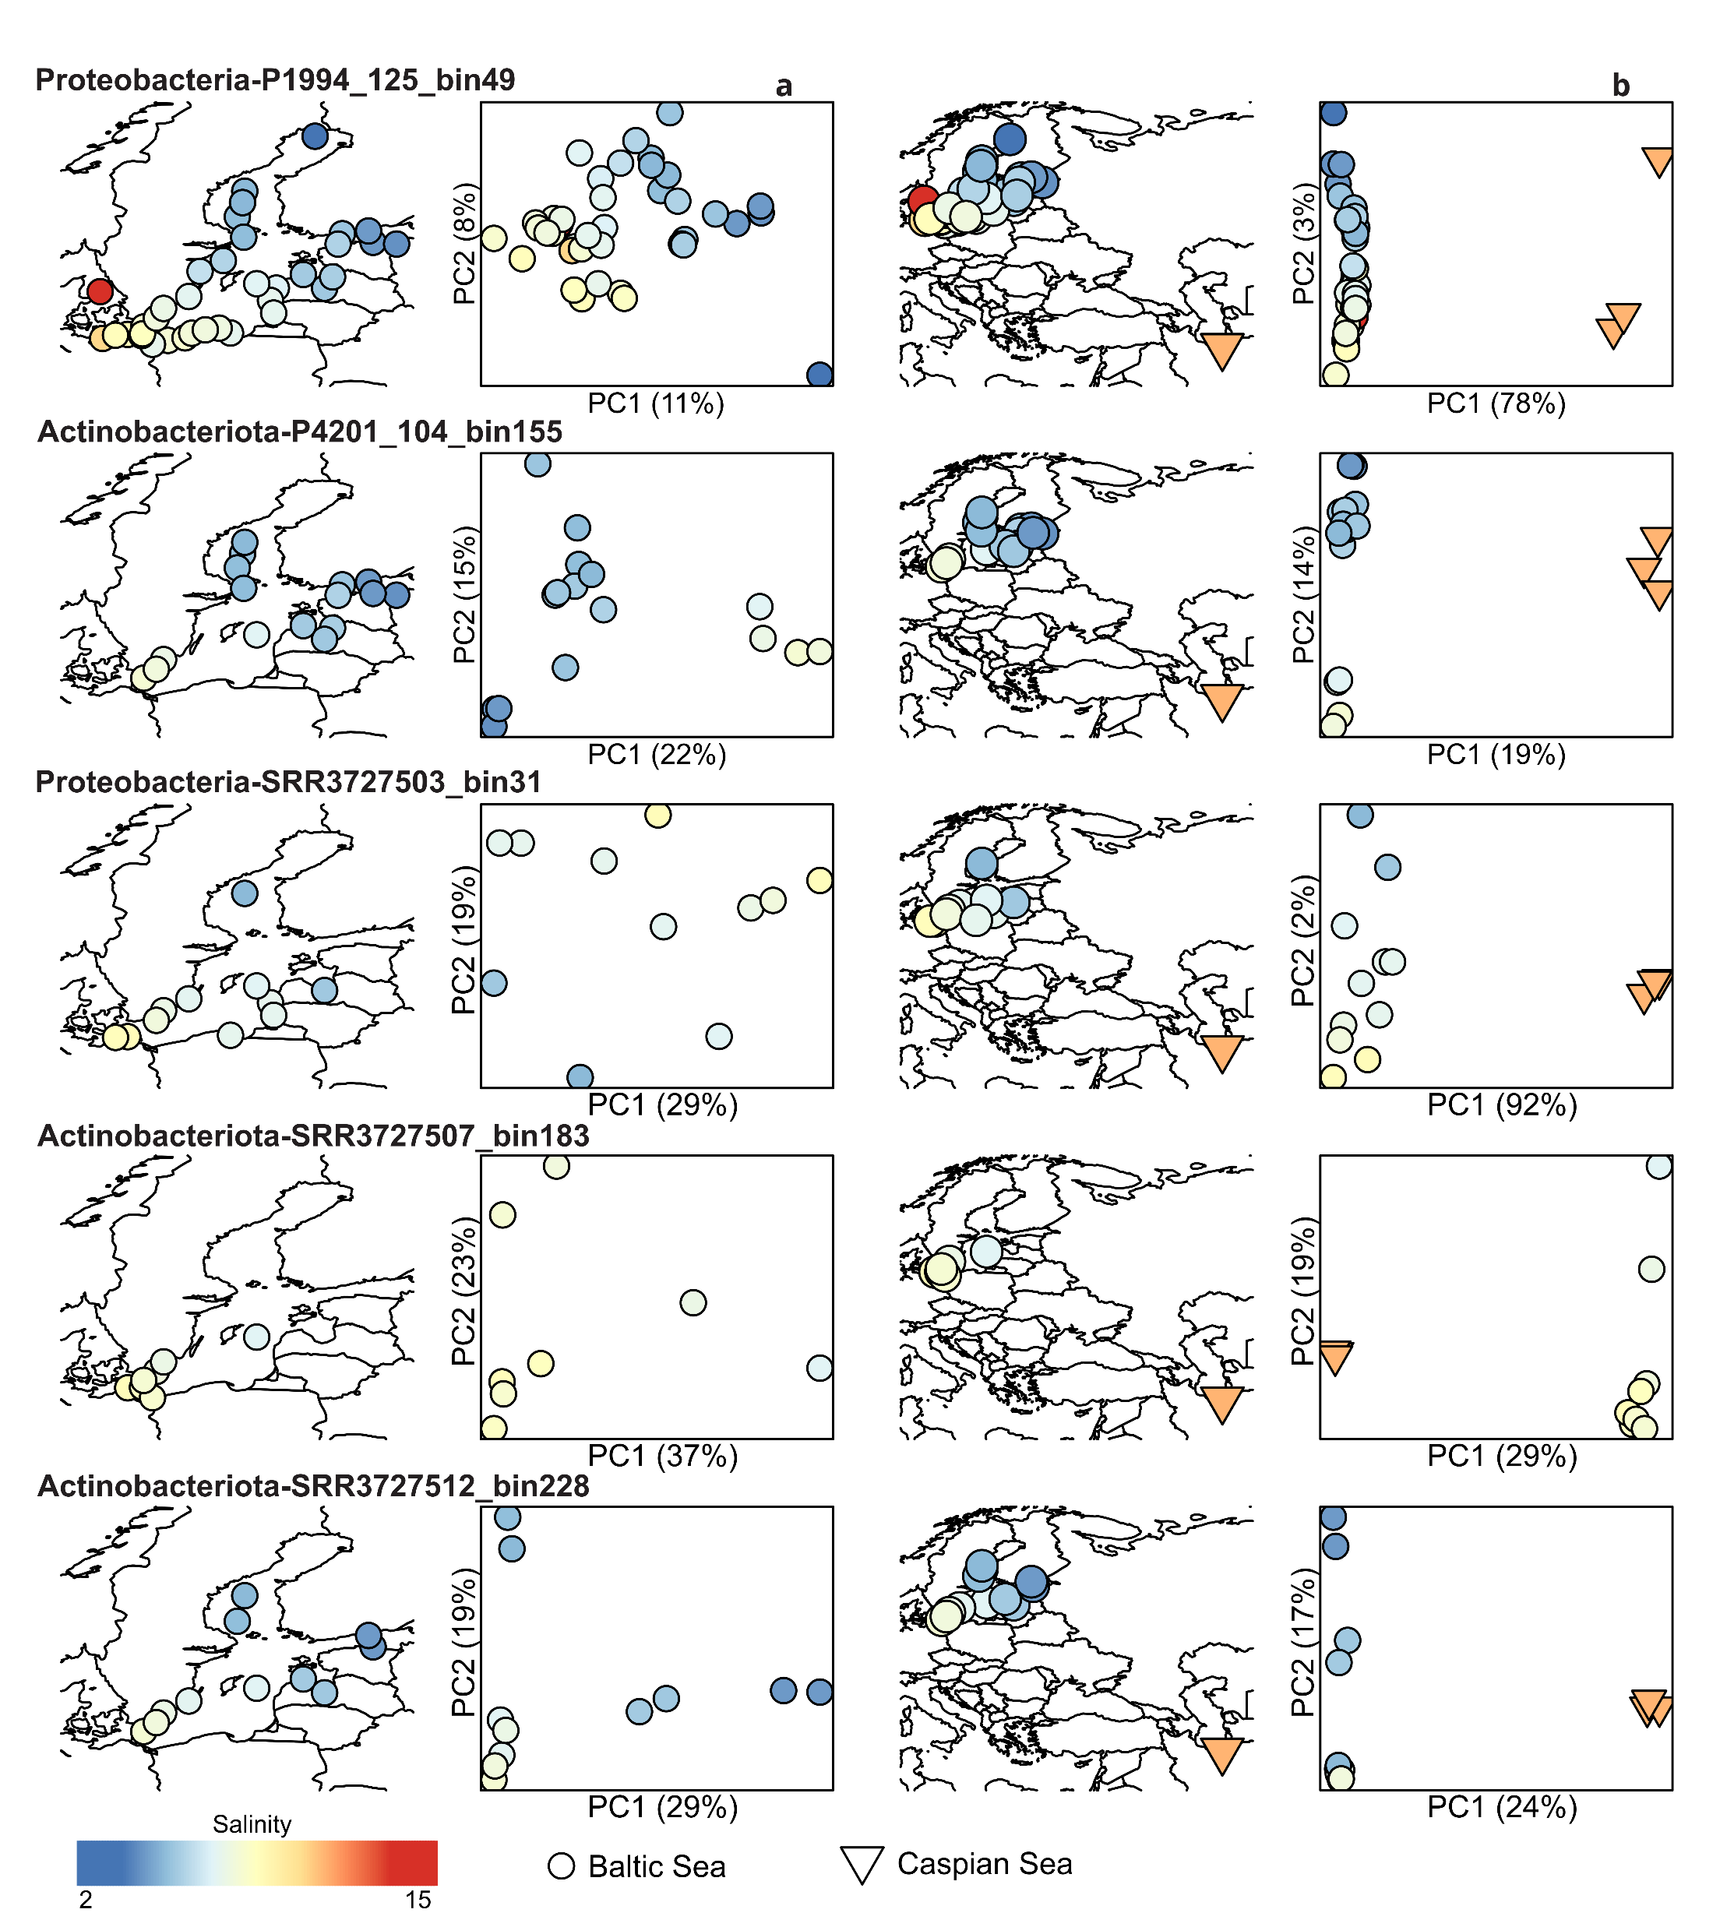
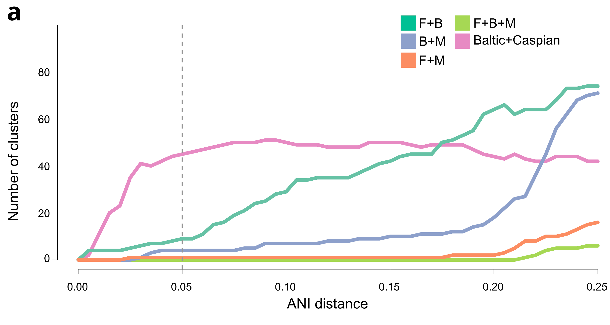
Species-level separation between biomes
Geographic micro diversity within brackish biome

Slide 4
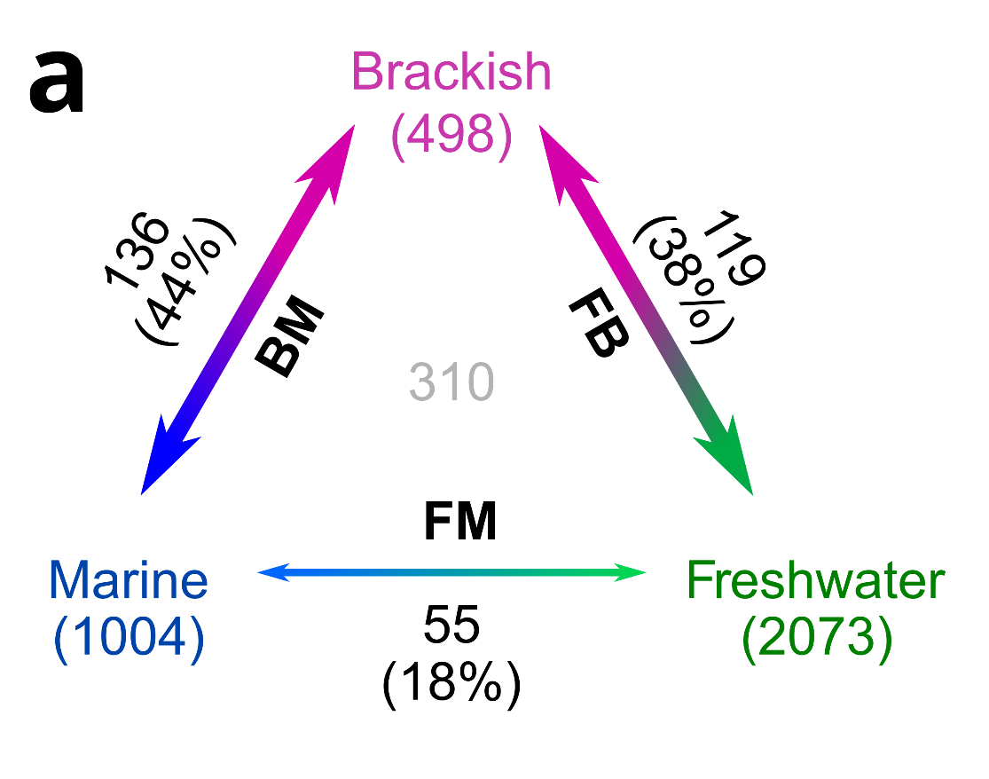
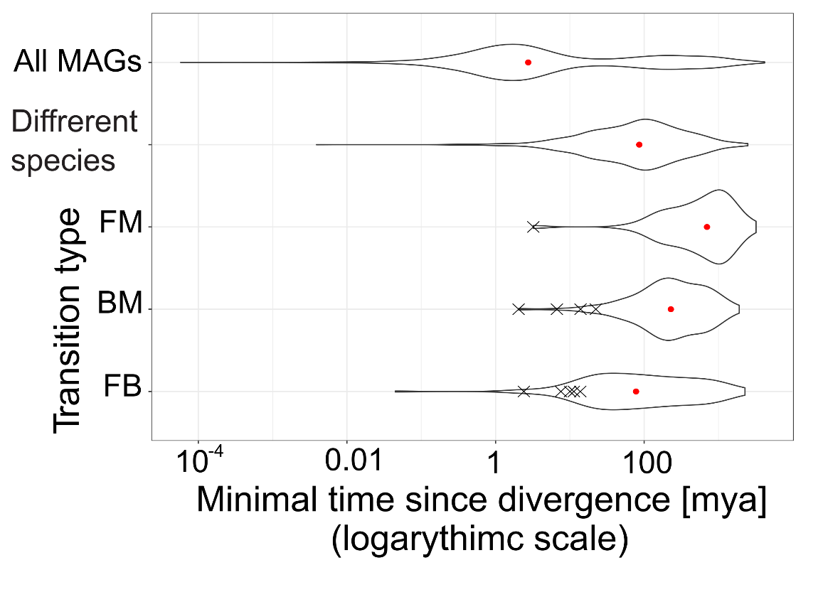
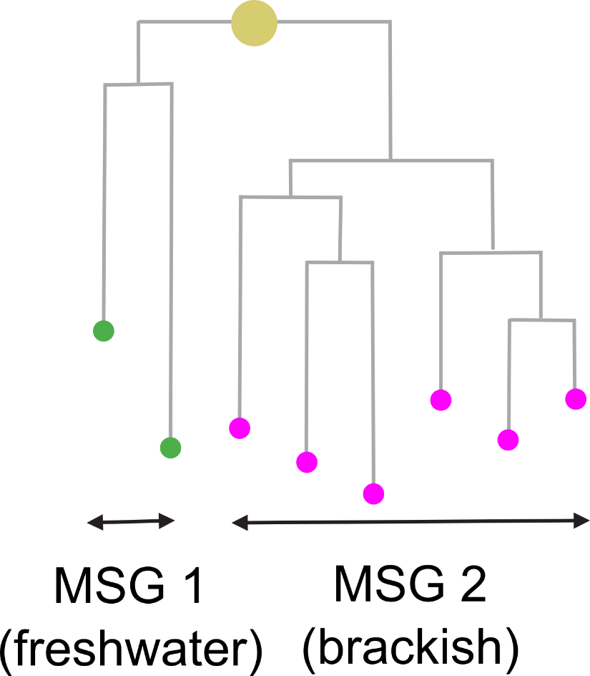
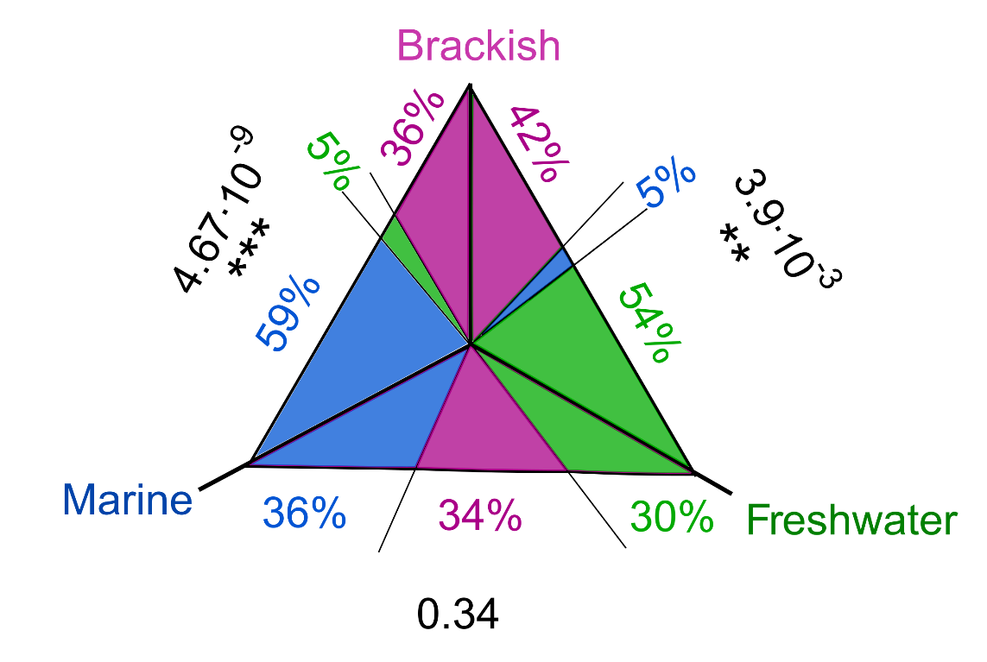
Cross-biome transitions were rare, ancient and more often into than out of the brackish biome
Transitions as pairs of monobiomic sister groups (MSGs)
Age of: Baltic Sea Caspian Sea
8 kya
2-3 mya

Slide 5
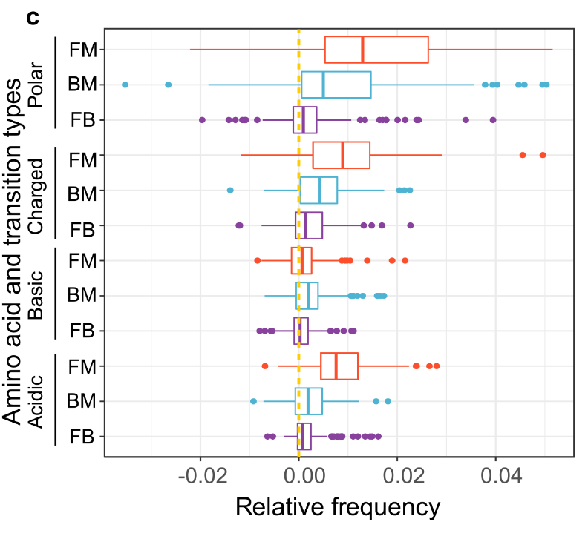


Wide-scale changes in proteome properties are driven by differences in the frequency of acidic amino acids
Inspired by Cabello-Yeves and Rodriguez-Valera (2019)

Slide 6
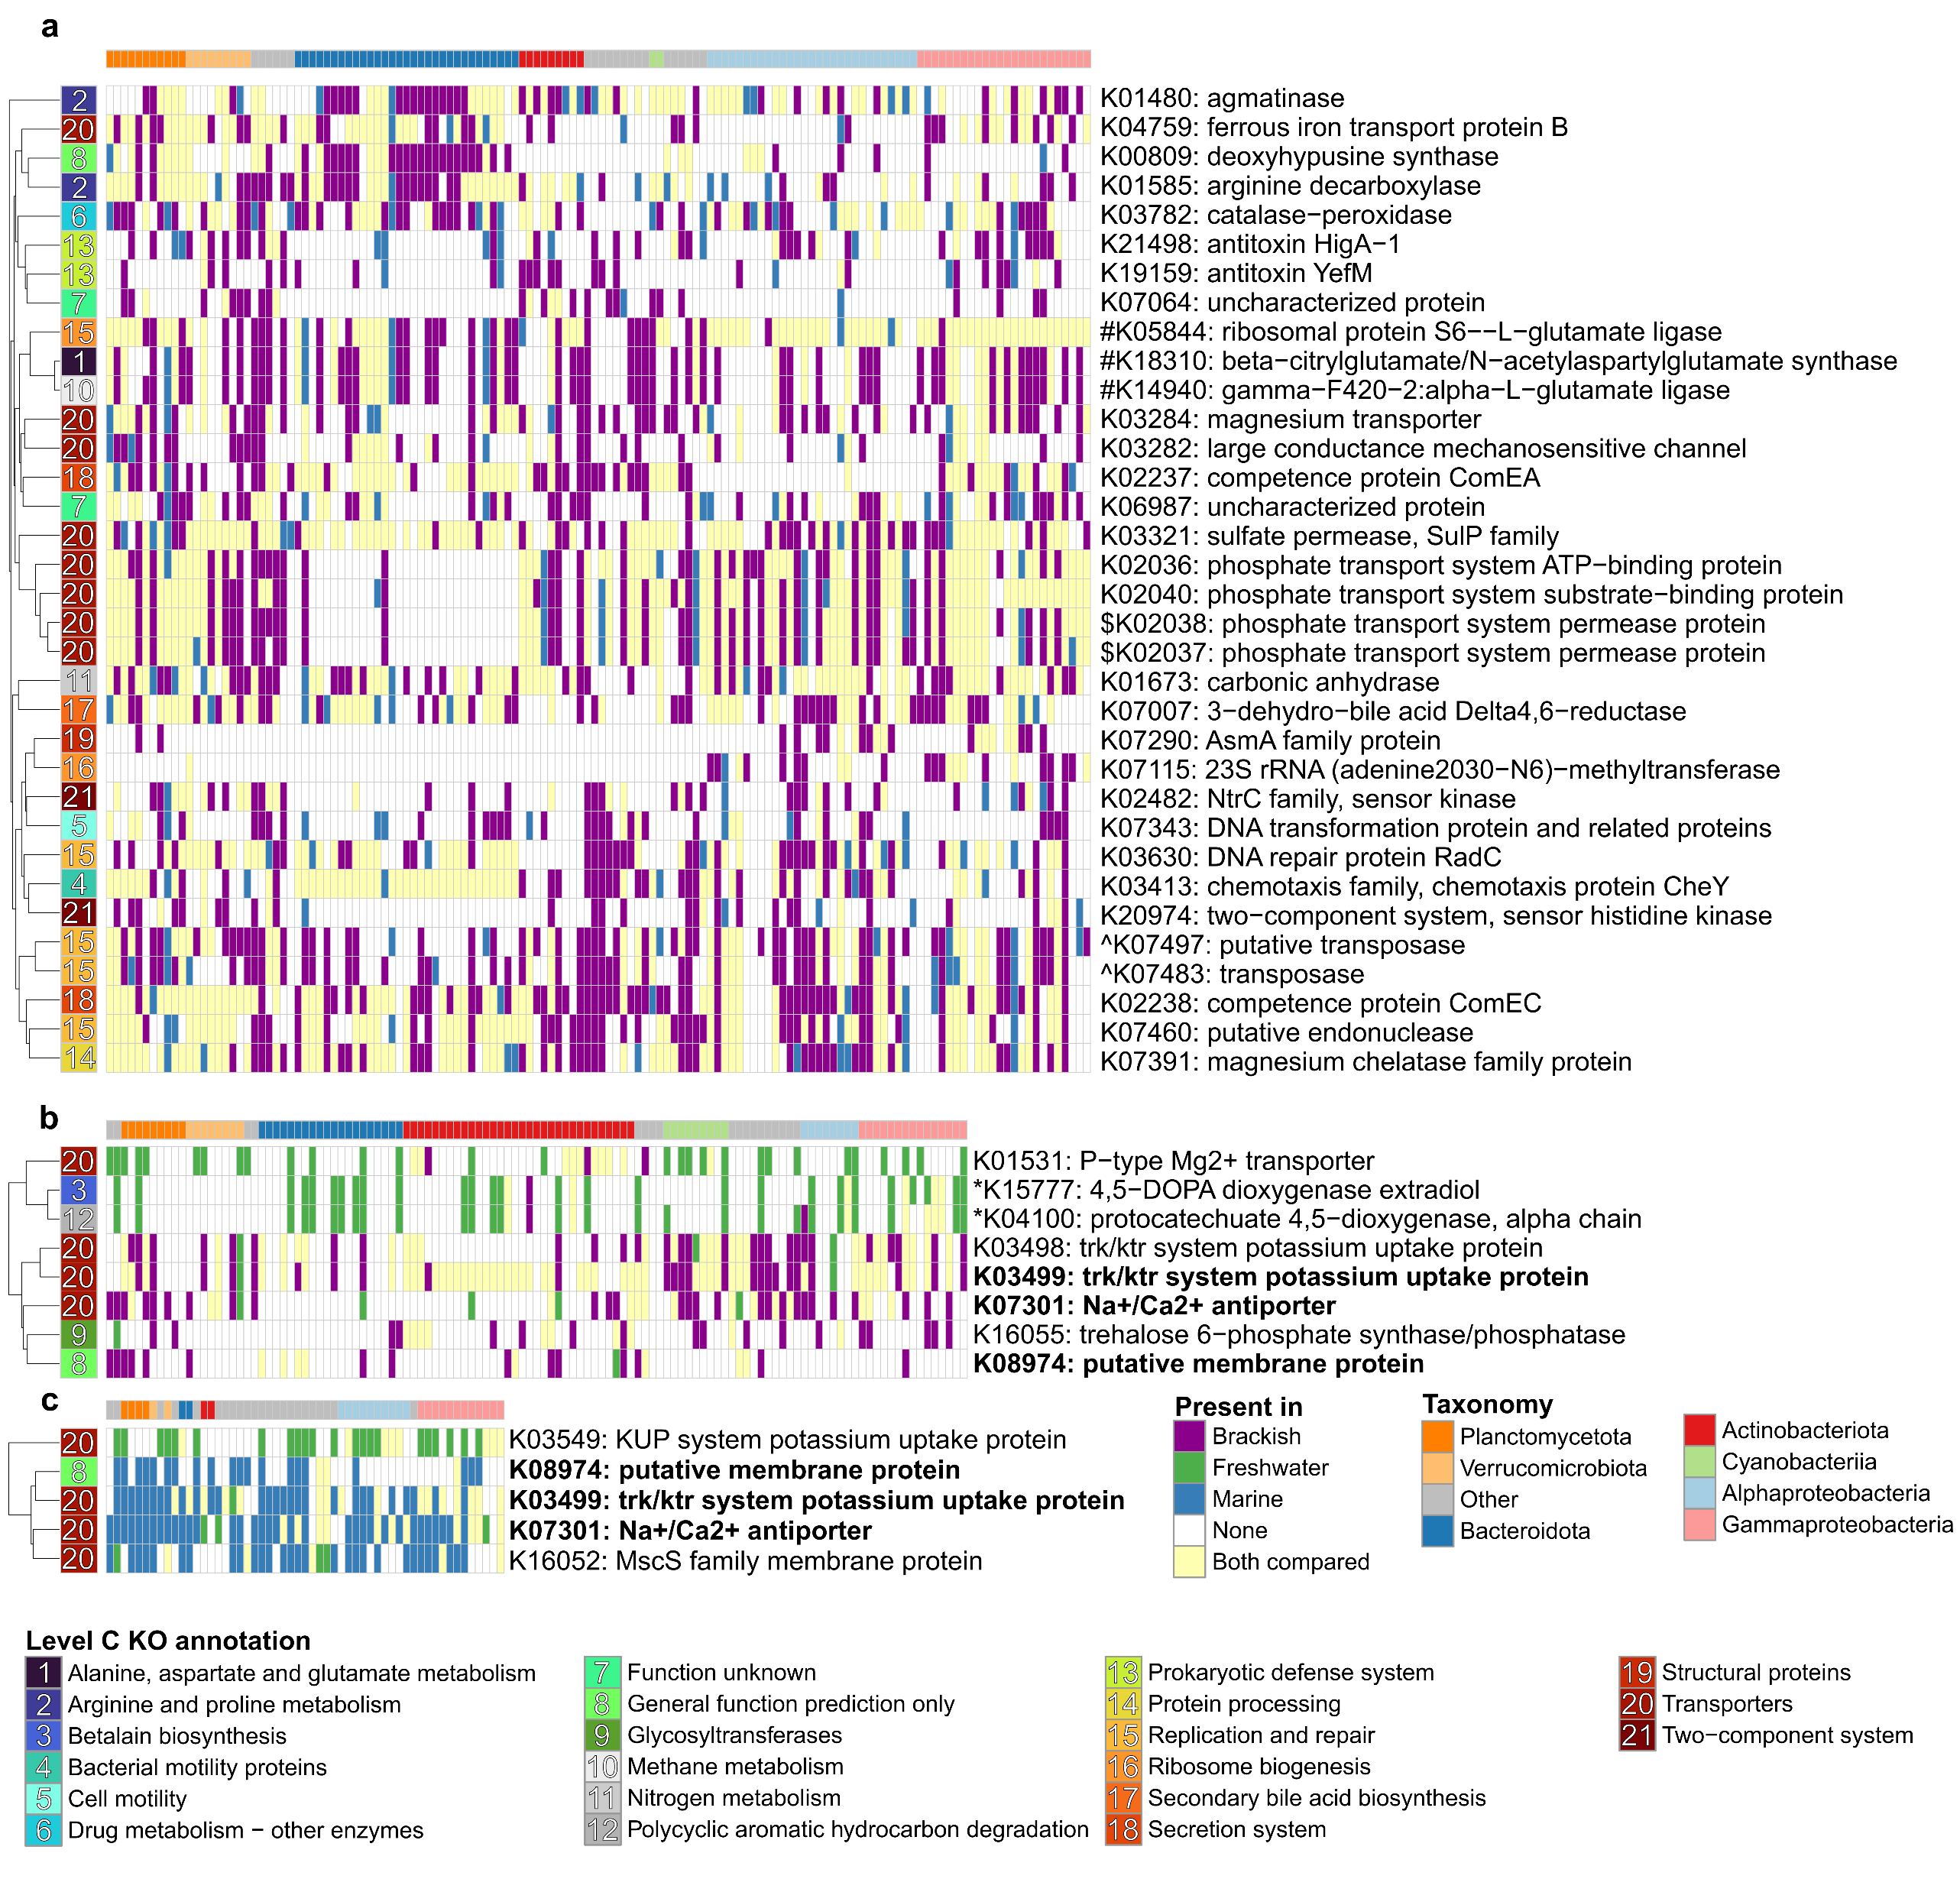
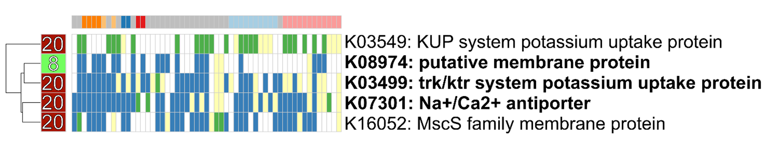
Gains and/or losses of the same functional genes allow diverse bacteria to transition between biomes
Freshwater ↔ Brackish
Marine ↔ Brackish
Freshwater ↔ Marine

Slide 7
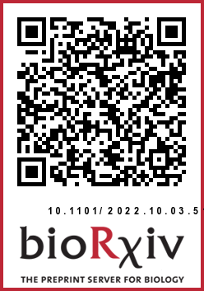
Conclusions
Different species inhabit different biomes.
Cross-biome transitions are rare, ancient (mya) and more often into than out of the brackish biome.
Cross-biome transitions lead to wide-scale changes in proteome composition…
…and gain or loss of specific gene functions.
Large-scale phylogenomics of aquatic bacteria reveal molecular mechanisms for adaptation to salinity
Krzysztof T Jurdzinski, Maliheh Mehrshad, Luis Fernando Delgado, Ziling Deng, Stefan Bertilsson, Anders F Andersson

